Slide 1
Introduction to Software Testing
Dr. Durga Prasad Mohapatra
Professor
Department Of Computer Science & Engineering
NIT Rourkela
03/08/10
1
1
1
1

Slide 2
Software Development Process

Slide 3
Software Life Cycle
Software Development Life Cycle (or software development process):
  Series of identifiable stages that a software product undergoes during its life time:
    Feasibility study
    Requirements analysis and specification,
    Design,
    Coding,
    Testing
    Maintenance.

Slide 4
Classical Waterfall Model
Classical waterfall model divides life cycle into following phases:
  Feasibility study,
  Requirements analysis and specification,
  Design,
  Coding and unit testing,
  Integration and system testing,
  Maintenance.
Conceptualize
Retire
Specify
Design
Maintain
Deliver
Code
Test

Slide 5
Classical Waterfall Model
Feasibility Study
Simplest and most intuitive
Req. Analysis
Design
Coding
Testing
Maintenance

Slide 6
Defect Reduction Techniques
Review
Testing
Formal verification
Development process
Systematic methodologies
6

Slide 7



Why Test?
Ariane 5 rocket self-destructed 37 seconds after launch
Reason: A control software bug that went undetected
  Conversion from 64-bit floating point to 16-bit signed integer value had caused an exception
    The floating point number was larger than 32767
    Efficiency considerations had led to the disabling of the exception handler.
Total Cost: over $1 billion
7

Slide 8
How Do You Test a Program?
Input test data to the program.
Observe the output:
  Check if the program behaved as expected.
8

Slide 9
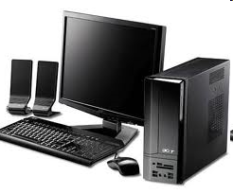


How Do You Test a Program?
9

Slide 10
How Do You Test a Program?
If the program does not behave as expected:
  Note the conditions under which it failed.
  Later debug and correct.
10

Slide 11
What’s So Hard About Testing ?
Consider int proc1(int x, int y)
Assuming a 64 bit computer
  Input space = 2¹²⁸
Assuming it takes 10secs to key-in an integer pair
  It would take about a billion years to enter all possible values!
  Automatic testing has its own problems!
11
Notes:
(But, can think about doing this many tests today)

Slide 12
Testing Facts
Consumes largest effort among all phases
  Largest manpower among all other development roles
  Implies more job opportunities
About 50% development effort
  But 10% of development time?
  How?
12

Slide 13
Testing Facts
Testing is getting more complex and sophisticated every year.
  Larger and more complex programs
  Newer programming paradigms
13

Slide 14
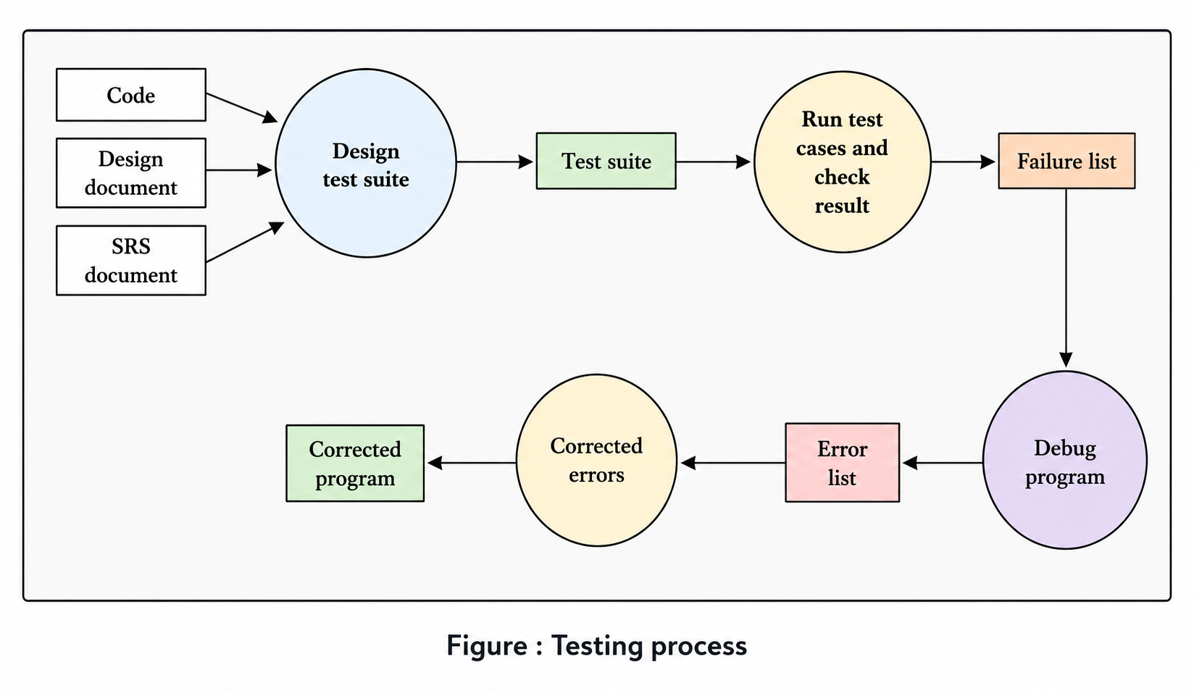

Slide 15
Overview of Testing Activities
Test Suite Design
Run test cases and observe results to detect failures.
Debug to locate errors
Correct errors.
15

Slide 16
Error, Faults, and Failures
A failure is a manifestation of an error (also defect or bug).
  Mere presence of an error may not lead to a failure.
16

Slide 17
Pesticide Effect
Errors that escape a fault detection technique:
  Can not be detected by further applications of that technique.
17

Slide 18
Pesticide Effect
Assume we use 4 fault detection techniques and 1000 bugs:
  Each detects only 70% bugs
  How many bugs would remain
  1000*(0.3)⁴=81 bugs
18

Slide 19
Fault Model
Types of faults possible in a program.
Some types can be ruled out
  Concurrency related-problems in a sequential program
19

Slide 20
Fault Model of an OO Program
OO Faults
Structural Faults
Algorithmic Faults
Procedural Faults
Traceability Faults
OO
Faults
Incorrect Result
Inadequate Performance
20

Slide 21
Hardware Fault-Model
Simple:
  Stuck-at 0
  Stuck-at 1
  Open circuit
  Short circuit
Simple ways to test the presence of each
Hardware testing is fault-based testing
21

Slide 22
Software Testing
Each test case typically tries to establish correct working of some functionality
  Executes (covers) some program elements
  For restricted types of faults, fault-based testing exists.
22

Slide 23
Test Cases and Test Suites
Test a software using a set of carefully designed test cases:
  The set of all test cases is called the test suite
23

Slide 24
Test Cases and Test Suites
A test case is a triplet [I,S,O]
  I is the data to be input to the system,
  S is the state of the system at which the data will be input,
  O is the expected output of the system.
24

Slide 25
Aim of Testing
The aim of testing is to identify all defects in a software product.
However, in practice even after thorough testing:
  one cannot guarantee that the software is error-free.
25

Slide 26
Aim of Testing
The input data domain of most software products is very large:
  it is not practical to test the software exhaustively with each input data value.
26

Slide 27
Aim of Testing
Testing does however expose many errors:
  testing provides a practical way of reducing defects in a system
  increases the users' confidence in a developed system.
27

Slide 28
Aim of Testing
Testing is an important development phase:
  requires the maximum effort among all development phases.
In a typical development organization:
  maximum number of software engineers can be found to be engaged in testing activities.
28

Slide 29
Aim of Testing
Many engineers have the wrong impression:
  testing is a secondary activity
  it is intellectually not as stimulating as the other development activities, etc.
29

Slide 30
Aim of Testing
Testing a software product is in fact:
  as much challenging as initial development activities such as specification, design, and coding.
Also, testing involves a lot of creative thinking.
30

Slide 31
Levels of Testing
Software products are tested at three levels:
  Unit testing
  Integration testing
  System testing
31

Slide 32
Unit testing
During unit testing, modules are tested in isolation:
  If all modules were to be tested together:
    it may not be easy to determine which module has the error.
32

Slide 33
Unit testing
Unit testing reduces debugging effort several folds.
  Programmers carry out unit testing immediately after they complete the coding of a module.
33

Slide 34
Integration testing
After different modules of a system have been coded and unit tested:
  modules are integrated in steps according to an integration plan
  partially integrated system is tested at each integration step.
34

Slide 35
System Testing
System testing involves:
  validating a fully developed system against its requirements.
35

Slide 36
Verification versus Validation
Verification is the process of determining:
  Whether output of one phase of development conforms to its previous phase.
Validation is the process of determining:
  Whether a fully developed system conforms to its SRS document.
36

Slide 37
Verification versus Validation
Verification is concerned with phase containment of errors,
  Whereas the aim of validation is that the final product be error free.
37

Slide 38
Design of Test Cases
Exhaustive testing of any non-trivial system is impractical:
  Input data domain is extremely large.
Design an optimal test suite:
  Of reasonable size and
  Uncovers as many errors as possible.
38

Slide 39
Design of Test Cases
If test cases are selected randomly:
  Many test cases would not contribute to the significance of the test suite,
  Would not detect errors not already being detected by other test cases in the suite.
Number of test cases in a randomly selected test suite:
  Not an indication of effectiveness of testing.
39

Slide 40
Design of Test Cases
Testing a system using a large number of randomly selected test cases:
  Does not mean that many errors in the system will be uncovered.
Consider following example:
  Find the maximum of two integers x and y.
40

Slide 41
Design of Test Cases
The code has a simple programming error:
If (x>y) max = x;
else max = x;
Test suite {(x=3,y=2);(x=2,y=3)} can detect the error,
A larger test suite {(x=3,y=2);(x=4,y=3); (x=5,y=1)} does not detect the error.
41

Slide 42
Design of Test Cases
Systematic approaches are required to design an optimal test suite:
  Each test case in the suite should detect different errors.
42

Slide 43
Design of Test Cases
There are essentially three main approaches to design test cases:
  Black-box approach
  White-box (or glass-box) approach
  Grey-box (or model based) approach
43

Slide 44
Black-Box Testing
Test cases are designed using only functional specification of the software:
  Without any knowledge of the internal structure of the software.
For this reason, black-box testing is also known as functional testing.
44

Slide 45
Black-box Testing Techniques
There are many approaches to design black box test cases:
  Equivalence class partitioning
  Boundary value analysis
  State table based testing
  Decision table based testing
  Cause-effect graph based testing
  Orthogonal array testing
  Positive-negative testing
45

Slide 46
White-box Testing
Designing white-box test cases:
  Requires knowledge about the internal structure of software.
  White-box testing is also called structural testing.
46

Slide 47
White-Box Testing Techniques
There exist several popular white-box testing methodologies:
  Statement coverage
  Branch coverage
  Path coverage
  Condition coverage
  MC/DC coverage
  Mutation testing
  Data flow-based testing
47

Slide 48
Coverage-Based Testing Versus Fault-Based Testing
Idea behind coverage-based testing:
  Design test cases so that certain program elements are executed (or covered).
  Example: statement coverage, path coverage, etc.
Idea behind fault-based testing:
  Design test cases that focus on discovering certain types of faults.
  Example: Mutation testing.
48

Slide 49
Why Both BB and WB Testing?
Black-box
Impossible to write a test case for every possible set of inputs and outputs
Some code parts may not be reachable
Does not tell if extra functionality has been implemented.
White-box
Does not address the question of whether or not a program matches the specification
Does not tell you if all of the functionality has been implemented
Does not discover missing program logic
49

Slide 50
Grey Box / Model Based Testing
In grey box testing, test cases are designed from design documents / models, such as UML diagrams.
Grey-box testing is also called model based testing.
Mainly used for testing of O-O systems.
50

Slide 51
Summary
Discussed importance of testing and the basic concepts of testing.
Presented the levels of testing.
  Unit testing
  Integration testing
  System testing
  Discussed the fundamentals of black box testing, white box testing and grey box testing.
*08/10/1003/08/10
51

Slide 52
References
R. Mall, Fundamentals of Software Engineering, (Chapter – 10), Fifth Edition, PHI Learning Pvt. Ltd., 2018.

Slide 53
Thank You
53

